Slide 1

Emotion Detection
Algovengers
Bansil Patel
Harsh Mohile
Meet Patel
Rachit Bhatt

Slide 2
Agenda
Overview
Dataset
EDA
Data Preprocessing
Neural Network
Conclusion

Slide 3

Overview
Analyze customer support conversations.
Extract emotions and visualize patterns.
Sentiment Analysis using NLP and DNN.
Enhance customer satisfaction and service quality in businesses.

Slide 4
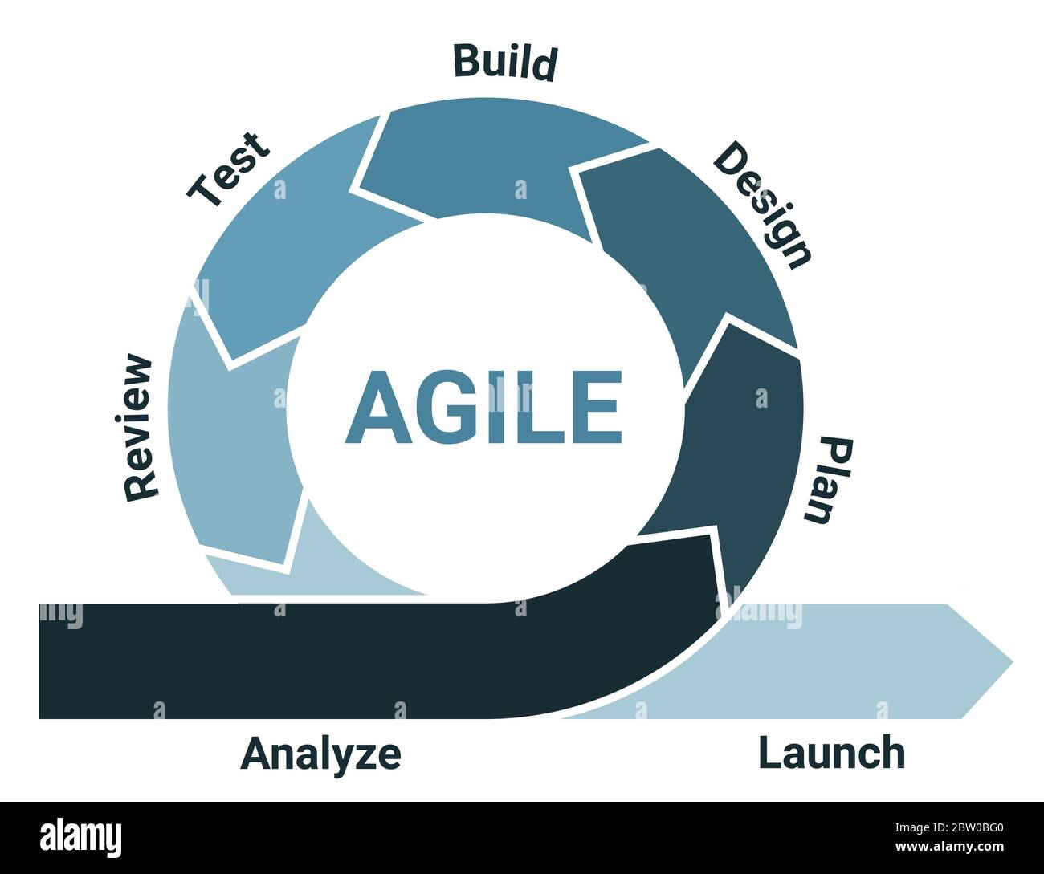
Process–Flow
Data Collection
Collected from Kaggle Dataset
Preprocessing
Group of Emotions, Stopwords Removal, Word Lemmatization, Tokenization, TF-IDF
Model
LSTM, GRU

Slide 5
Dataset – 211225 x 31
Link: Go Emotions: Google Emotions Dataset
https://www.kaggle.com/datasets/shivamb/go-emotions-google-emotions-dataset
Column | Description
id | ID of record.
text | Text from comment
example_very_unclear | Is the text very unclear (True|False)
Emotions | Which Emotion? (0|1)
Emotions:
Admiration
Amusement
Anger
Annoyance
Approval
Caring
Confusion
Curiosity
Desire
Disappointment
Disapproval
Disgust
Embarrassment
Excitement
Emotions:
Fear
Gratitude
Grief
Joy
Love
Nervousness
Optimism
Pride
Realization
Relief
Remorse
Sadness
Surprise
Neutral
Dimension: 211,225 x 31

Slide 6
Emotion Categories
Reduced dimension of emotions with three common emotions.
Emotions:
Negative (0)
Neutral (1)
Positive (2)

Slide 7
EDA – Exploratory Data Analysis
Understanding dataset and relationship.
Exploring patterns through visualization.

Slide 8
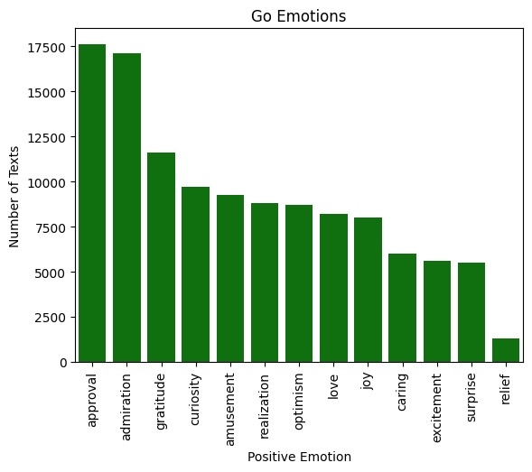
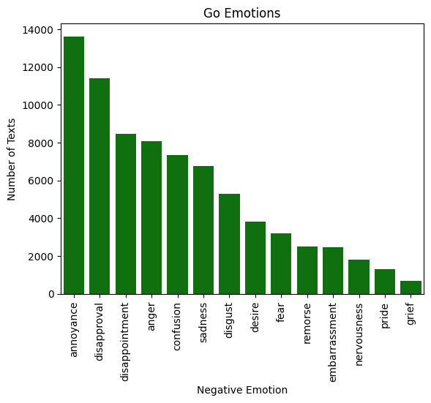
Data Visualization
Emotions based on tokens.
Emotions for Positive and Negative.

Slide 9
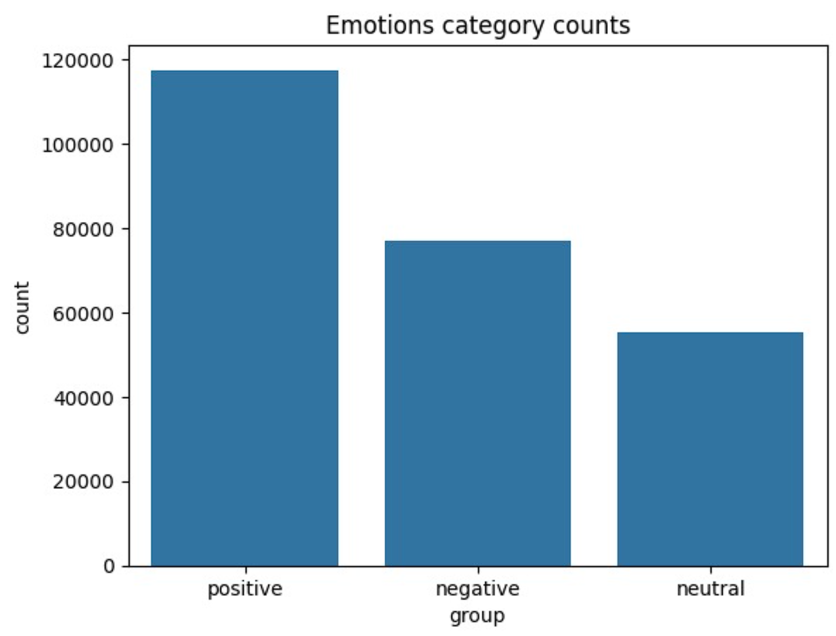
Data Visualization Cont.
Count for each category of Emotions.

Slide 10
Data Preprocessing
Removal of Stopwords.
TF-IDF Tokenization.

Slide 11
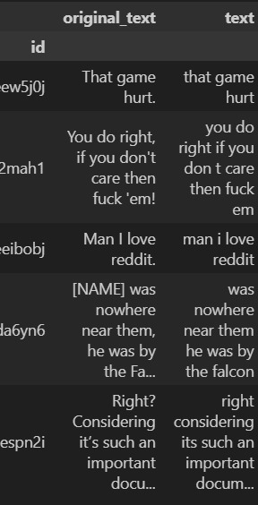
Data preprocessing
Used Regular Expression to remove brackets, urls, and other symbols.
The result is stored in the DataFrame for each original text.

Slide 12
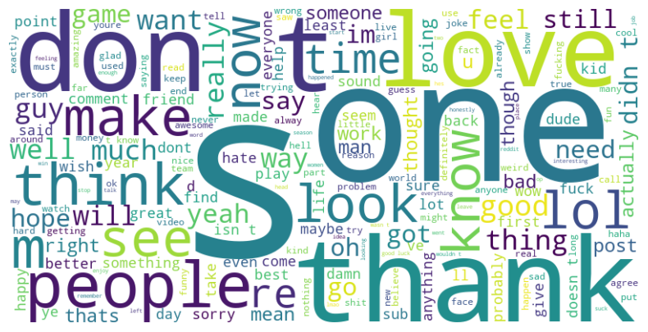
WordCloud
Common words in the text.
Most words describes neutral emotions as showed earlier.

Slide 13
Models
Used LSTM + GRU.
Hyperparameters
Learning Rate: 0.001
Optimizer: Adam
Early Stopping: Validation Loss
Patience: 5

Slide 14
Model Training
Train-Test: 70-30 Split
X: Vectorized Text
Y: Encoded Labels

Slide 15
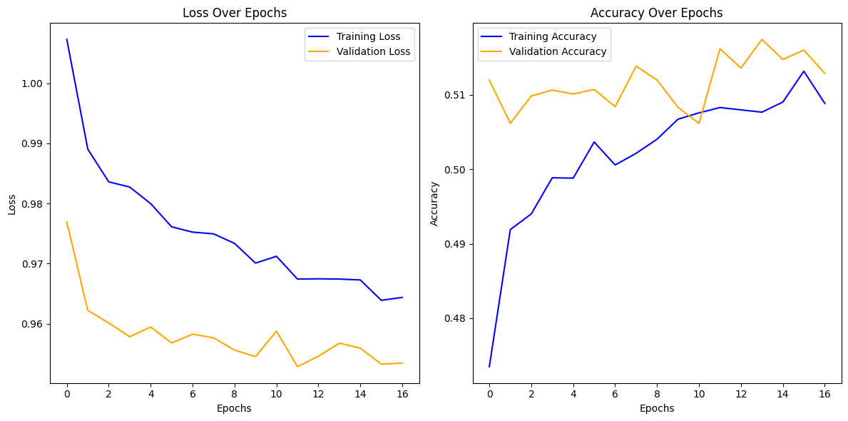
LSTM
Loss decreased around 95%.
Accuracy was stabilized at 51%.

Slide 16
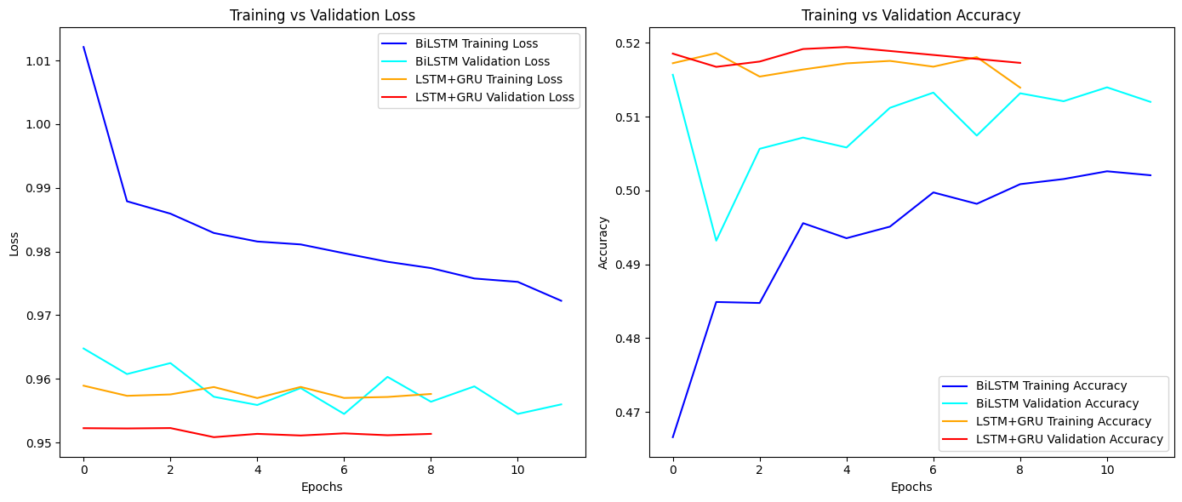
BiLSTM + GRU
Accuracy increased a little after hyperparameters at 52%.
Loss decreased and sustained at 95%.

Slide 17
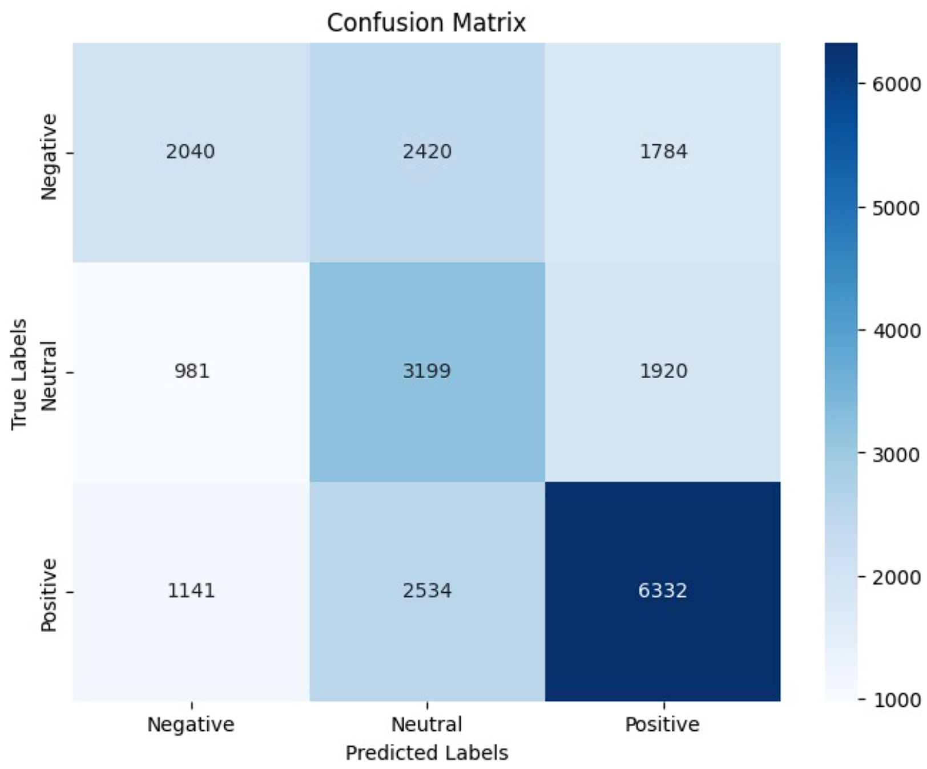
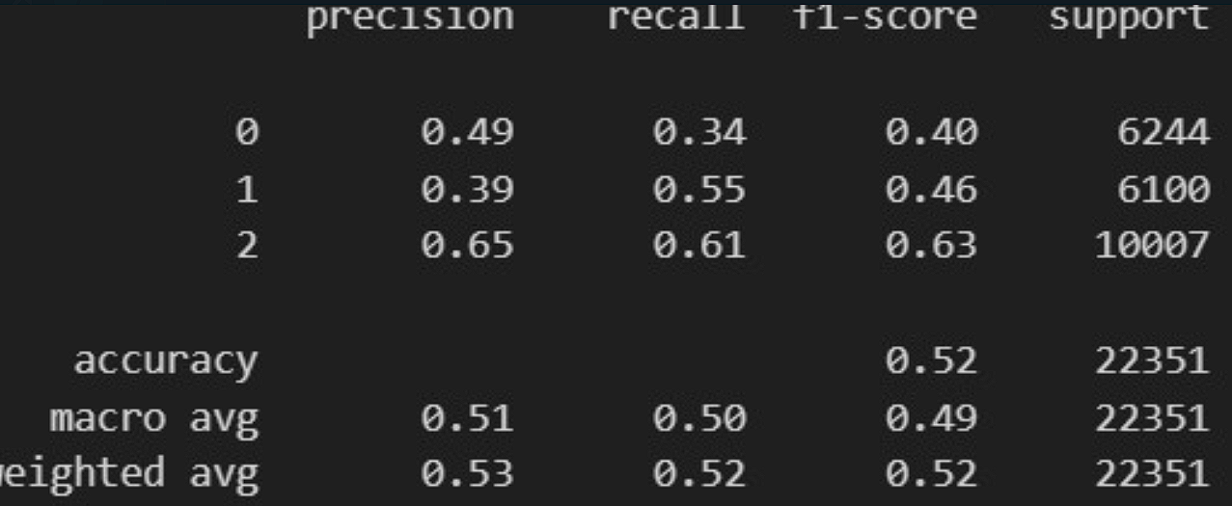
Confusion Matrix and Classification Report
LSTM + GRU

Slide 18

Conclusion
Benefits: Emotion detection enhances service quality and customer satisfaction.
Key Takeaway: Emotion analysis help businesses proactively address customer needs.
Future Scope: Deployment on cloud-based web app with rich UI and perform real-time analysis with reinforcement learning.

Slide 19
Thank you
Emotion Detection
Team Algovengers
Project Proposal
Neural Network and Deep Learning

